Slide 1
Learning the Popularity Prediction in Information Cascades
Team S23-35:
Will Postler, Paul Brinkmann, Ian Johnson, Evan Gossling, Bailey Gorlewski
Client & Advisor: Dr. Goce Trajcevski
05/03/2023

Slide 2
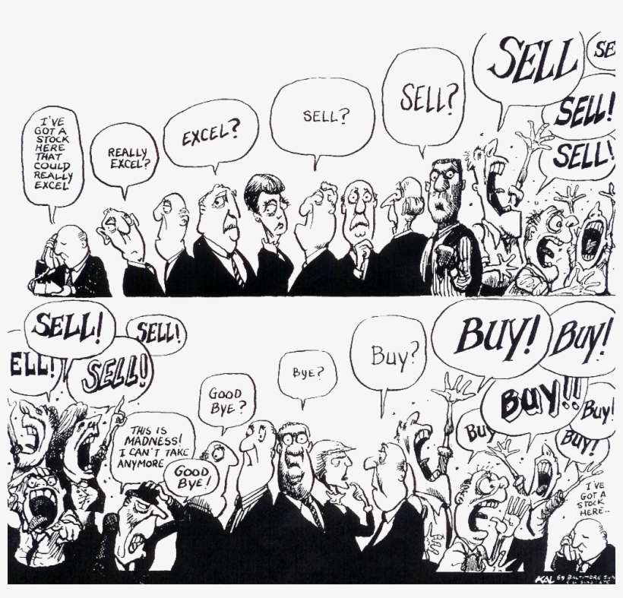
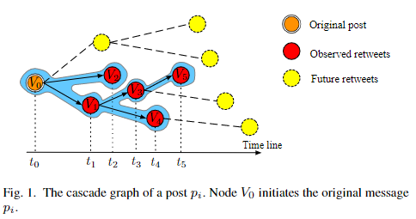
Background
(What are Information Cascades?)
Social Media Study
Market study experiment
Notes:
An informational cascade or Information cascade is a phenomenon described in behavioral economics and network theory in which a number of people make the same decision in a sequential fashion. It is similar to, but different from herd behavior.
The biggest difference between an information cascade and herd behavior is that in an information cascade, individuals actively ignore their private information to instead follow the decision of their neighbors, while for herd behavior that’s not necessarily true.
Predicting cascades and their size are useful for: rumor detection, advertising/marketing, academic papers, social media, and so on.
Image Left: You can see a cascade of retweets in a social network. One would want to know that side of a cascade like that.
Image Right: You can see a market, where people use solely their neighbors to make decisions, completely forgoing their own private information. Goes from Excel to Sell, then To buy.
Directed Acyclic Graph (DAG)
VaCas(Variational Cascade) or CasCN(Recurrent Cascades Convolutional Networks)

Slide 3
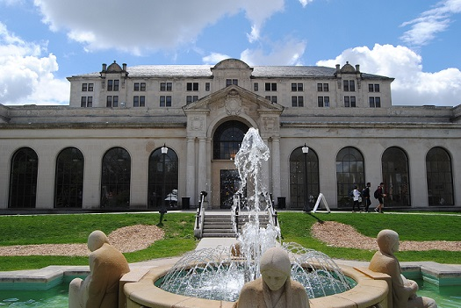
Project Vision
What are we accomplishing and why?
Intended Users
Individual Scientist
Funding Institution
University Administrator
Notes:
(technical terms) We are developing an end-to-end system that will provide such functionalities for the users interested in visualizing locations related to popularity cascades in the context of scientific paper citations.
Our project focuses on popularity cascades in the context of scientific paper citations.
(simple terms) We are developing a website which will allow users to generate predicted charts, maps, and graphs from a dataset the user would input. This will allow them to visualize the potential popularity of their (for example, research paper)
A big portion of our project is geo-visualizations of the predictions, so showing the predictions on a map.
Individual
Look universities that have a higher chance of getting more citations on their paper.
Find the location on where to study a particular topic
Funding
See which universities have higher predicted citations to allocate funding
University Administrators
Boast about their institutions and predicted citations

Slide 4
Project Overview
End-to-end system to provide a solution for our intended users
Map visualization & citation graphs
Utilizes a Flask backend with a vanilla Javascript frontend.

Slide 5
Standards
IEEE 830 - Software Requirements Specifications
IEEE 1016 - Software Design Descriptions
IEEE 12207 - Software Life Cycle Processes
IEEE 1028 - Software Reviews and Audits
Notes:
Here are our standards, for more information and justification, please see our final report.

Slide 6
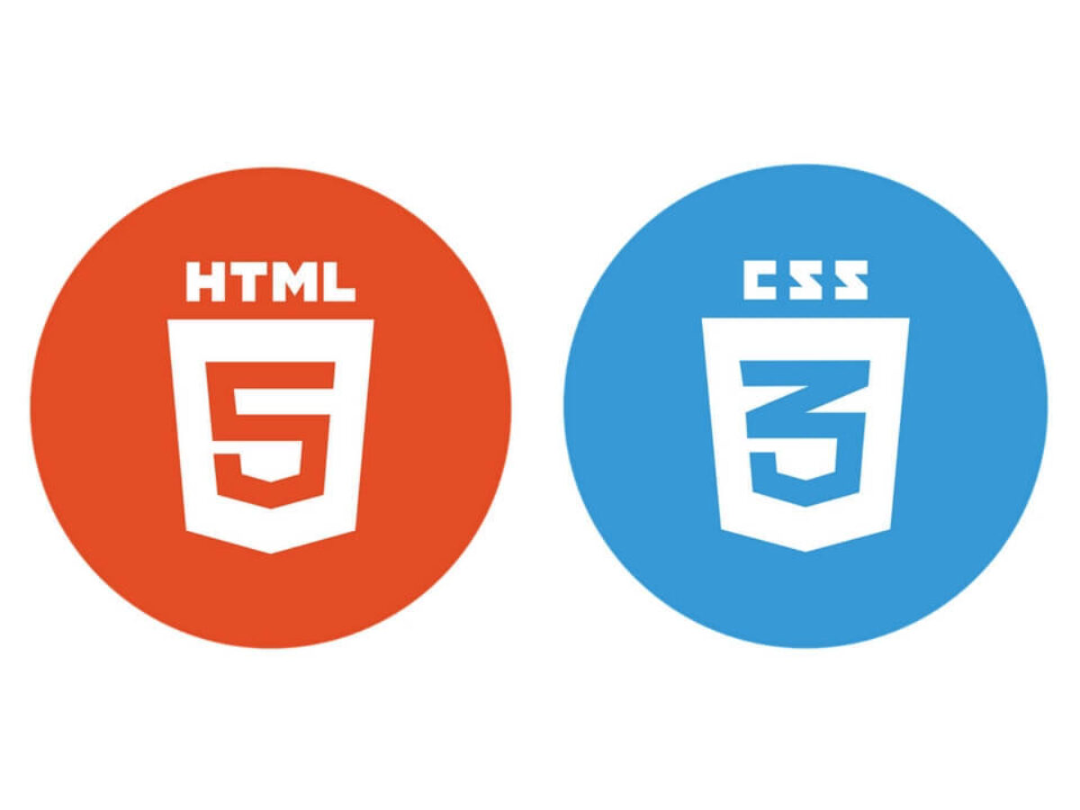
Skills Learned and Expanded Upon
Python
Flask
HTML/Javascript/CSS
JS Libraries (jQuery, Ajax)
Mapbox
MySQL
Docker
CI/CD
Information Cascade Models

Slide 7
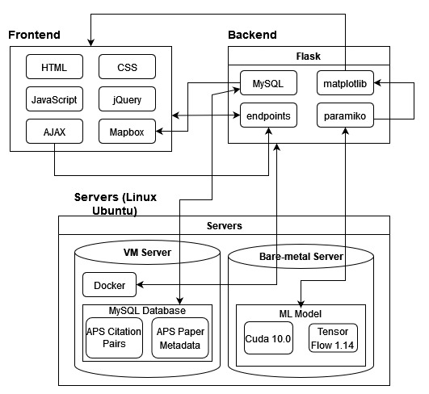
Implementation Architecture - Software
Main modules
Frontend
Backend
Servers
Interfacing
Additional software
Notes:
Explain: Main modules, Important modules that stand out, and Interfacing between these modules.
User Systems:
Dataset Configuration (Responsible for allowing external datasets or a user to provide own dataset)
Model Training Configuration
Prediction Configuration
User Visualization (Responsible for displaying map data though MabBox API)
Backend Systems:
Location Generation System (Responsible for obtaining the location data from the predictions)
Dataset Management System (Responsible for loading and storing datasets)
Model Training Service (Responsible for training the prediction model)
Prediction Management System (Responsible for generating new predictions)
Data Management System (Responsible for presenting location data to the user)
Docker is used to containerize our application to allow it to run on different platforms/use specialized versions

Slide 8
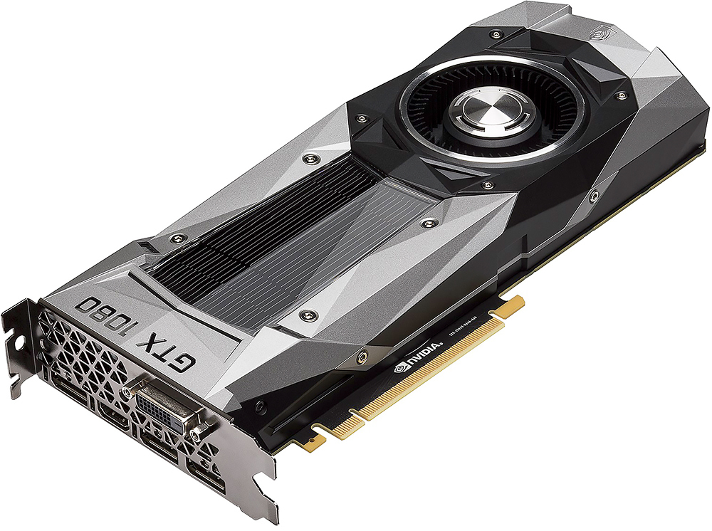
Implementation Architecture - Hardware
Physical Server Provided by ETG:
CPU: Intel(R) Xeon(R) Bronze 3106 CPU
RAM: 8 GB
GPU: GTX 1080
OS: Ubuntu 20.04
VM Provided by ETG:
CPU: Intel(R) Xeon(R) Gold 6140 CPU
RAM: 8 GB
OS: Ubuntu 20.04

Slide 9
Implementation: UI (Initial)
Notes:
Bring up => as we mentioned in the document more explicitly, there were certain changers that we made in our initial design. One of them is related to our UI, this is our initial vision and the next slide is the final implementation

Slide 10
Implementation: UI (Final)
Notes:
Graphs show this
Pindrops show this
etc

Slide 11
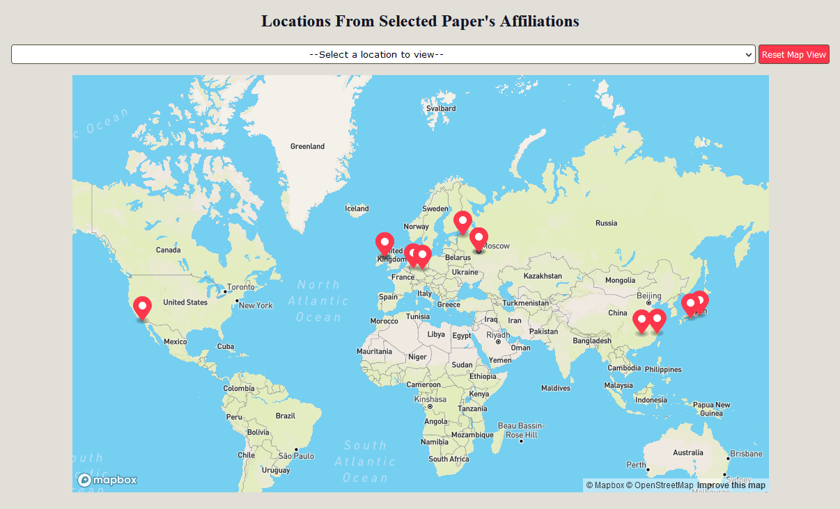
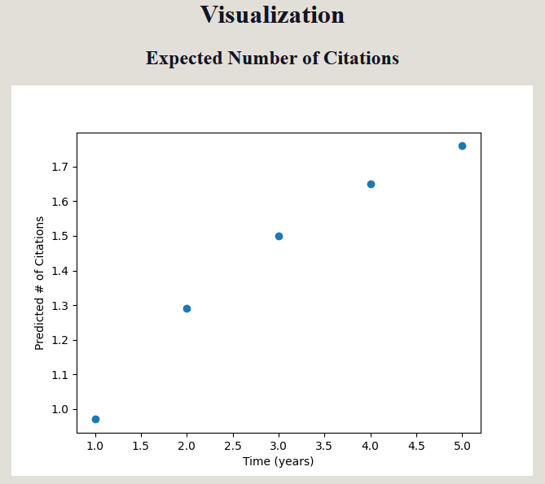
Implementation: UI (Final)
Notes:
Graphs show this
Pindrops show this
etc

Slide 12
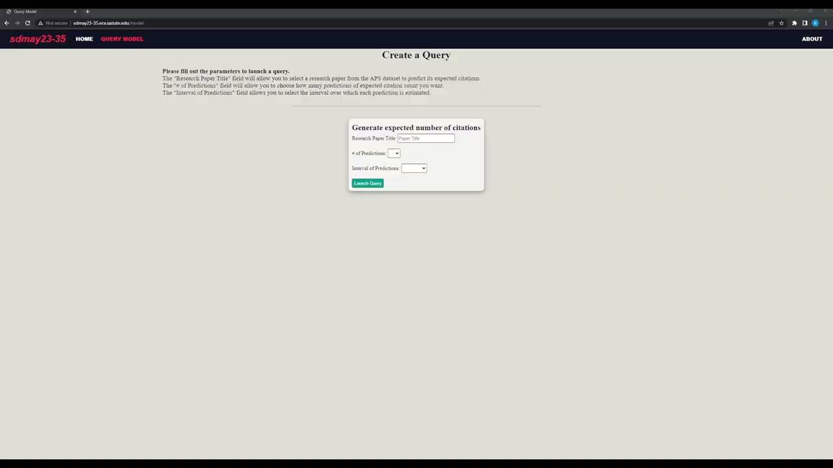
Demo

Slide 13
Testing
Pytest unit testing
Interface testing
Integration testing
Regression testing
Acceptance testing
System testing
Notes:
For details see final report section: page:

Slide 14
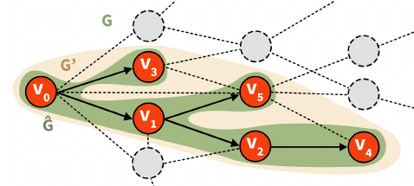
Work Accomplishments
Design Infrastructure
Initialize Database with dataset
Implement UI Design
Create Queries
Implement backend ML logic
Data Visualization
CI/CD Pipeline

Slide 15
Key Contributions
Bailey: CI/CD setup with Gitlab & Docker. Mapbox setup & forward geocoding
Ian: UI development/Frontend. ETG server/resource acquisition
Evan: Flask backend setup & model mapping
Paul: Database setup & maintenance, importing & formatting datasets, unit tests
Will: Setup client meetings

Slide 16
Challenges and Solutions
Challenge: Usage of React
Solution: Usage of vanilla JavaScript with JS libraries
Challenge: Provided model utilized older versions of library (Cuda 10.0)
Solution: Model was trained on additional server with older hardware by PhD student Ce Li
Challenge: Dataset did not follow standard format for all sections
Solution: Script was created to scrape and properly format data to be imported
Notes:
React:
Did not end up needing to use react as it over complicated our system, and vanilla JS was completely serviceable and met all needs
Model:
Required older version of CUDA incompatible with gpu/server, attempted old drivers by us and Ce, eventually acquired new hardware and Ce finished setup
Dataset:
APS dataset was not completely standardized/not all the data

Slide 17
Future Work & Extensions
User supplied datasets
Currently only APS (future: could add Aminer or others)
Training of models based on additional datasets
Models would need to be trained for each dataset
New models/algorithms (VaCas, CasCN, etc.)
Only HINTS currently used
More filtering options
Filtering based on region, general topics, etc.
Additional queries
Query for nth most prolific paper, 10 best papers (based on citations), etc.

Slide 18
Conclusion
End-to-end system
Flask, Javascript, Mapbox
Lots of functionality to be added/expanded on
Notes:
What did we do (we presented ….)
In summary, we did x, y, z

Slide 19
Questions?
Notes:
Come visit us at Coover Hall at 3:30

